Slide 1
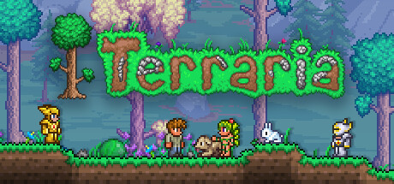
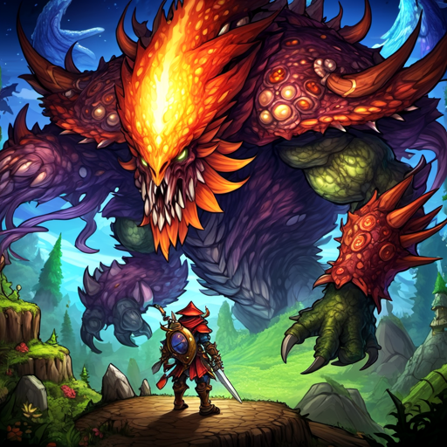

Terraria Sequel
From BestGameStudio(BGS)

Slide 2
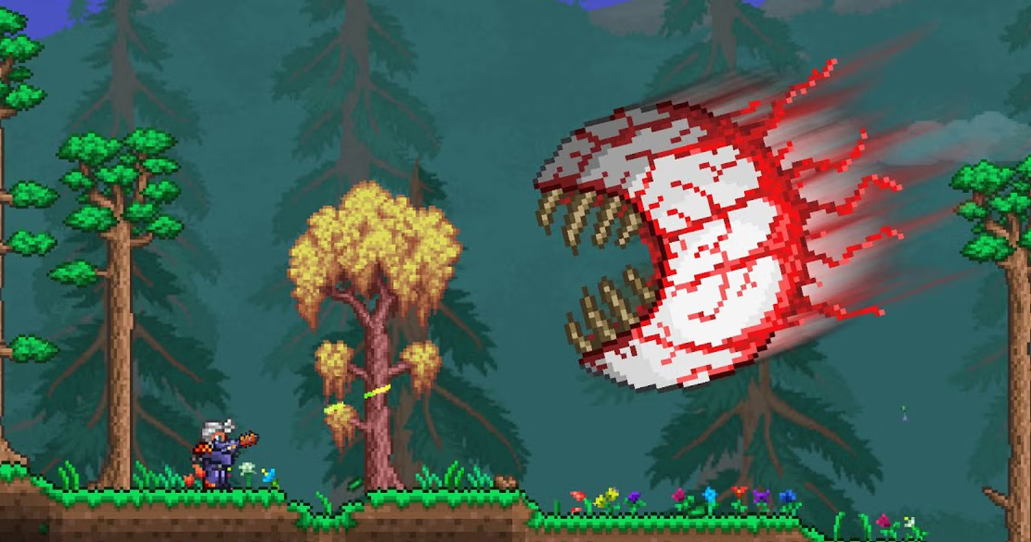
Terraria
A 2-D action adventure sandbox game where you are combating a series of monstrous bosses to upgrade your weapons and equipment while traveling in procedurally generated worlds

Slide 3
Original Loop diagram
Gathering Resources
Crafting
Kill Bosses
Open treasures box, Smash pots
Collect natural resources
Kill monsters and animals
Build shelters
Craft tools and weapons
Craft potion and food
Find or Summon the boss
Fight with the Boss

Slide 4
Original onion diagram
Kill Bosses(pre-hardmode, Hardmode, Post endgame)
Exploring, NPC’s, Gear
Resources, Crafting, Fighting

Slide 5
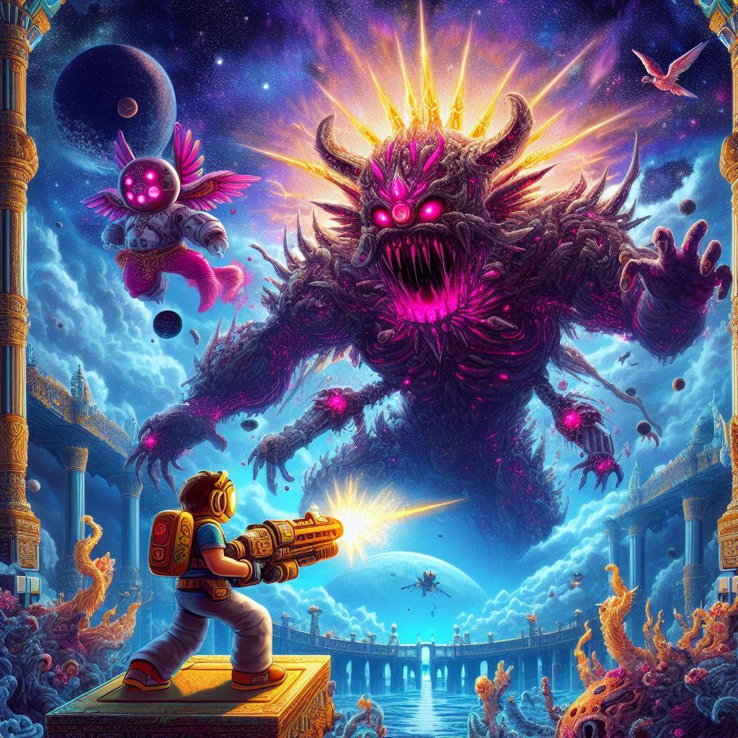
Sequel opportunity
Bigger and more varied biomes
Many planets with unique flora, fauna, bosses\monsters, and resources
More mobility options
Narrative progression
A cohesive lore and story to the universe and game
Increased scale: monsters, world , buildings

Slide 6
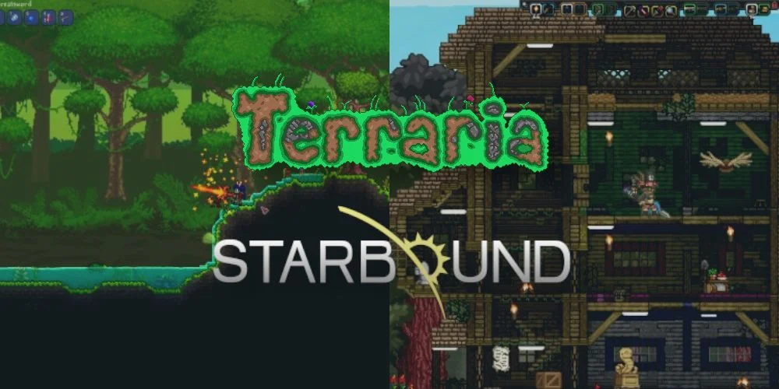
Astraria: Into the Empyrean
A 2-D action adventure sandbox game where you are combating a series of monstrous bosses through different planets to upgrade your weapons and equipment while traveling in procedurally generated planets

Slide 7
Innovated loop diagram
Build
Bases
Arena
traps
Explore
Planets
Space
Gather Resources
Accessories
Material
Tools/weapons
Craft
tools/weapons
Armor
Accessories
NPC
New quests
buy/sell resources
Progress
Story quest
weapons/tools
Exploring
Difficulty
Fight
Bosses
Monsters
PVP
Quest
Achievements
story/side quests
resources

Slide 8
Innovated onion diagram
restoring Terraria from astroworld bosses
fighting bosses and doing quests to progress until the final boss
building, flying, grappling, fishing
fighting, crafting, gathering, exploring

Slide 9
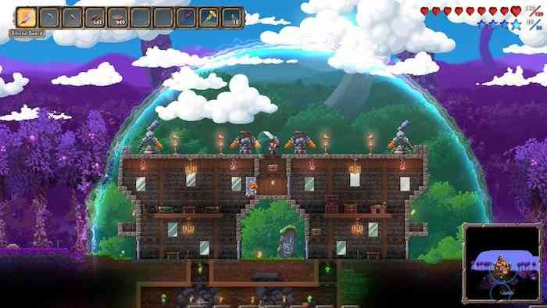
Differences
Terraria … IN SPACE!!!
Narrative progression
Old players motivation
Action
Creativity
Mastery
New players added motivation
Immersion
Achievement

Slide 10
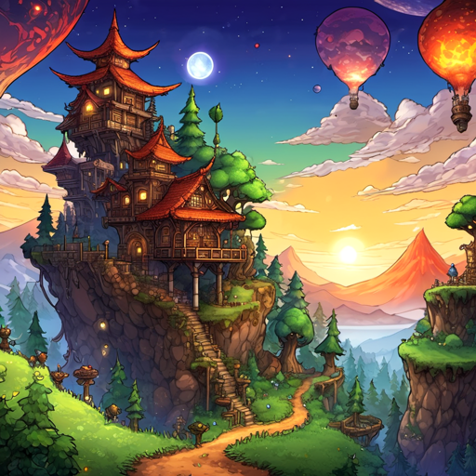
Why make a sequel?
Even in 2023 Terraria still has ~50,000 concurrent players per month
Game received a 9/10 on IGN and has over 1,000,000 reviews on steam with a 97% positive review rate
Over 45 million copies of the game have been sold
Sequel is highly anticipated by players
Terraria's mechanics and infrastructure are showing their age and have lots of opportunity to be refined and modernized
Because … Why not?

